Slide 1

FYP 1st Evaluation
Sensor Integrated System based Real Time and Online Monitoring for Organ on Chip platforms
Group member 1:
Wakeel Ahmed (033-19-0026)
Group member 2:
Muhammad Saqlain (033-20-0011)
Group member 3:
Faizan Ahmed (033-20-0032)
Supervisor:
Dr. Fida Hussain Memon

Slide 2
Outline
Introduction
Problem Statement
Proposed Solution
Aim & Objectives
Methodology
Availability of Components
Expected Results and Testing

Slide 3
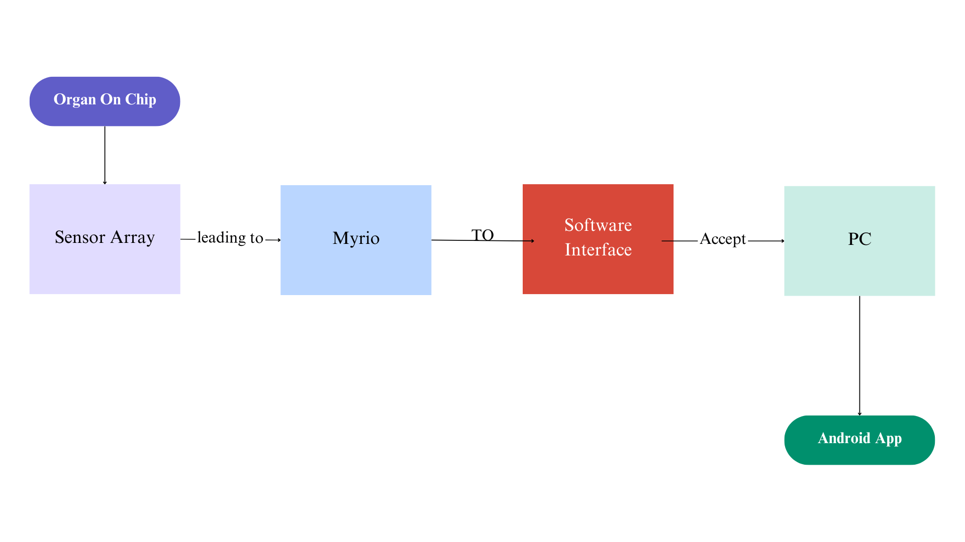
Introduction

Slide 4
Introduction
Data Acquisition
Data Processing
Sensor Data Handling
The PCB board captures data from sensors integrated with system.
The Software Interface processes raw sensor data from the PCB board.
Data is converted into a readable format for further analysis.
The system writes sensor data to a PC for real-time monitoring.
Ensures accurate and consistent data flow for monitoring and control.
Android App Integration
Purpose of the System
A dedicated Android app allows remote monitoring and control of the system.
The setup facilitates real-time monitoring of biological processes.
Provides flexibility for mobile real-time monitoring.
Aims to provide a connection between sensors, processing, and visualization tools.

Slide 5
Problem statement
Validation of new drugs require reliable platforms to ensure safety and intended result before clinical trials.
To design and develop sensor based micro physiological platform to quantify the organ on chip parameters like disease modelling and drug reproposing.
To Build the system to support multiple sensors.
Traditional methods of drug testing (experimentation on animals (e.g., mice), face increasing ethical and legal restrictions
Current systems does not provide and support online monitoring and remote interfaces.
To Develop a real-time monitoring system, an Android application to provide instant updates, to monitor data remotely and in parallel validation.
Proposed Solution

Slide 6
Aim
“To develop a Sensor Integrated Microphysiological System capable of real-time and online monitoring for efficient and accessible data acquisition and analysis for Organ on Chip Platforms.”

Slide 7
Objectives
Design and Development
Develop a hardware and software system for microphysiological data acquisition.
Enable Real-Time Online Monitoring
Integrate real-time data collection from sensors, and provide online monitoring capabilities via a PC and Android app.
Integration
Implement system that combines sensors, PCB, MyRIO, and remote monitoring tools.
Implement Data Visualization
Create software interface to visualize real-time data and enable control of the system.
Validate System Performance
Conduct testing to ensure reliable data acquisition, minimal delay, and accurate remote monitoring performance.

Slide 8
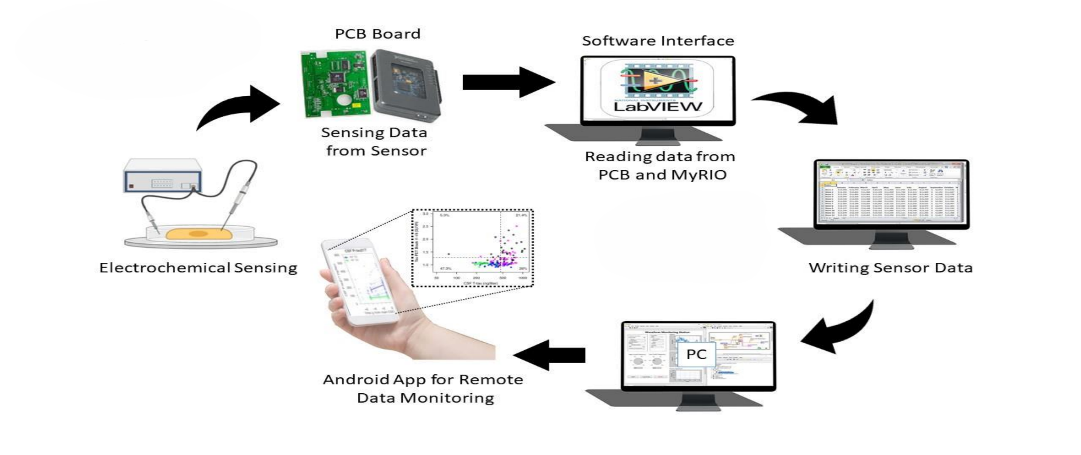
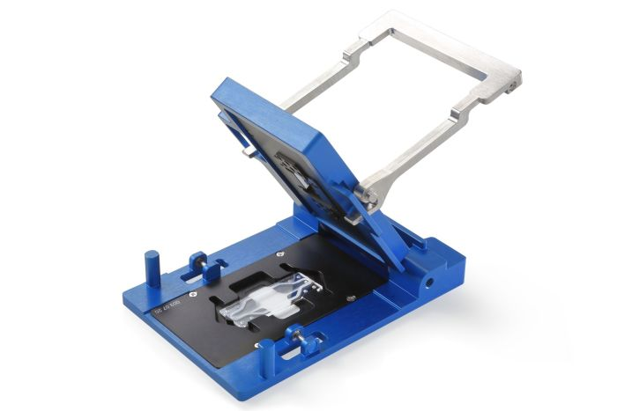
Methodology
Organ on Chip Platform

Slide 9
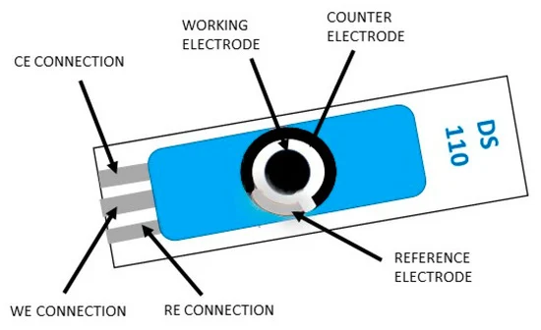
Amperometric Glucose Sensor
Working electrode
Auxiliary electrode/counter electrode
Reference electrode
https://metrohm-dropsens.com/products/electrodes/modified-screen-printed-electrodes/polypyrrole-modified-screen-printed-carbon-electrode/

Slide 10
Methodology
Electrochemical Sensing
Captures real-time data from the Sample.
PCB Board Integration
Processes data from the sensor for further analysis.
Interfaces with a PCB for signal processing.
Communicates with the NIMyrio.
Software Interface (LabVIEW)
Reads sensor data processed by the PCB and MyRIO.
Android App for Monitoring
Facilitates remote monitoring of real-time data.
Ensures smooth integration between hardware and virtual tools.
Offers a user-friendly interface for system interaction.

Slide 11
Methodology
PC for Local Processing
Hosts data analysis and visualization using software tools.
Data Flow
Sensors send real-time data to PCBs.
Data is routed to the NI MyRIO, which transmits it to a PC through a USB interface.

Slide 12
Availability of Components
PC (Personal Computer)
Available in our labs for processing, analyzing, and visualizing real-time sensor data.
NI MyRIO
Available in our labs, providing a reliable platform for data acquisition and processing.
PCB (Printed Circuit Board)
Custom-designed PCBs manufacturers in South Korea.
Commercial Sensors
Sourced from South Korea

Slide 13
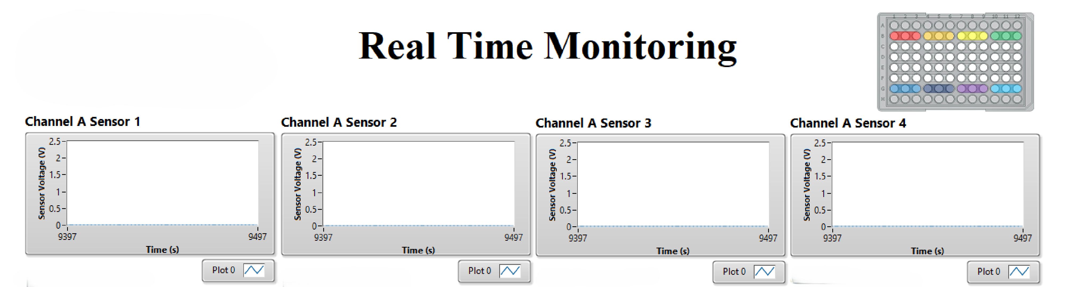
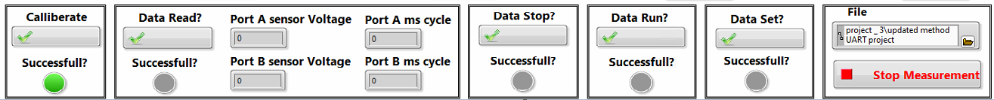

Slide 14
Real-Time Monitoring System
Monitoring Channels
Sensor Calibration
Data Input and Configuration
Each channel Supports one Sensor (Sensor 1, Sensor 2, Sensor 3, Sensor 4).
Each channel displays real-time voltage vs. time plots for sensor data.
Includes a calibration interface to set voltage and timing for each sensor port (Port A and Port B).
Allows manual configuration of:
Voltage range (0–2.5 V) for sensors.
Cycle time (milliseconds) for accurate data sampling.

Slide 15
Real-Time Monitoring System
Data Plotting
Measurement Control
User Interface
Real-time plotting of sensor output for visualization.
Equipped with a start/stop measurement button for user convenience.
Intuitive interface designed for easy navigation and control.
Offers tools for reading, writing, and plotting data during operation.
Provides file management options to save and load data configurations.
Displays a view of active sensor operations and outputs.

Slide 16
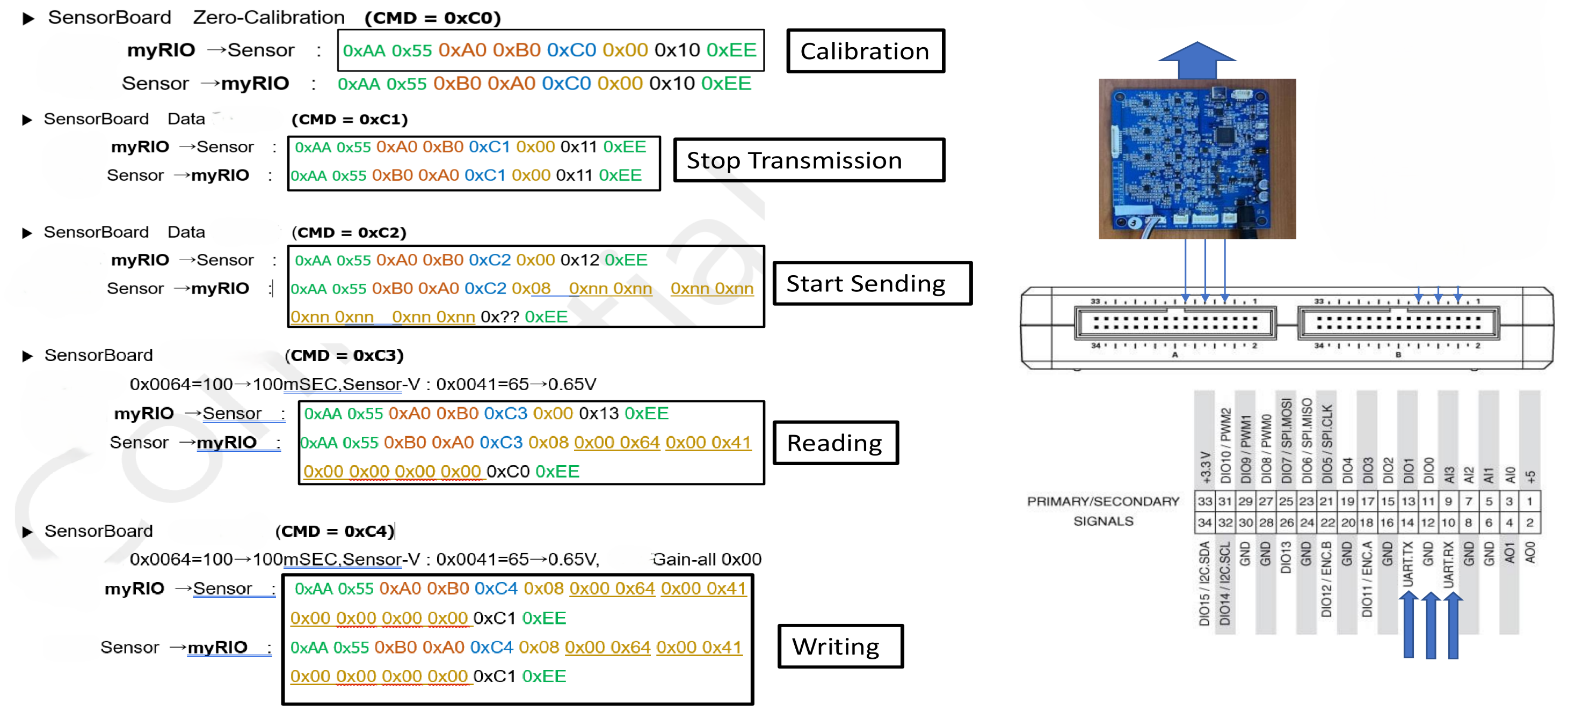
Sensor Communication and Commands

Slide 17
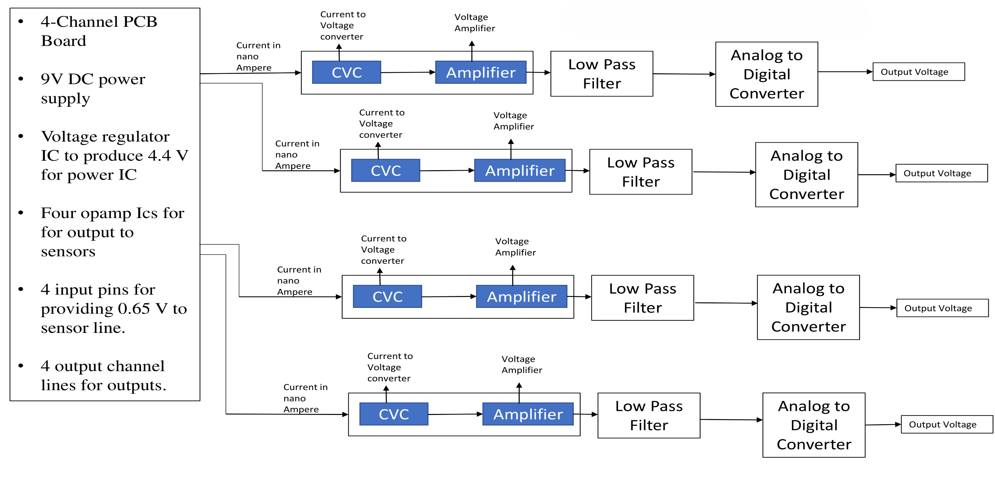
PCB Board Data Acquisition

Slide 18
PCB Board Data Acquisition
PCB Board Specifications
4-Channel PCB Board supports 4 sensors for real-time monitoring.
Input and Output Features
4 Input Pins: Provide 0.65V to the sensor for stimulation.
Powered by a 9V DC power supply with a voltage regulator IC for stable 4.4V output.
Equipped with four operational amplifier ICs for sensor signal processing.
4 Output Channels: Deliver processed signals to the system for further analysis.
Signal Processing Flow
Current-to-Voltage Converter (CVC):- Converts nano-ampere signals to voltage.
Amplifier:- Boosts the converted voltage for better signal strength.
Low-Pass Filter:- Removes noise and ensures signal integrity.
Analog-to-Digital Converter (ADC):- Converts the analog signal to digital format for output.

Slide 19
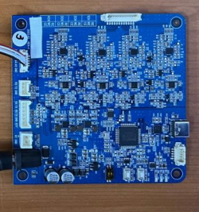
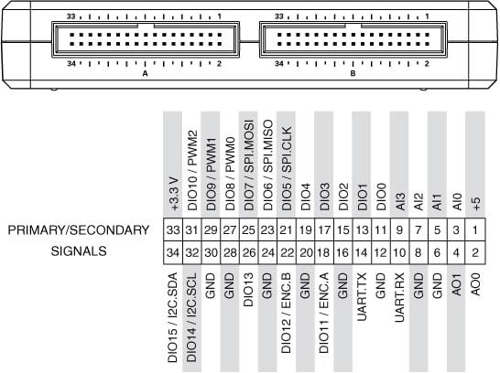
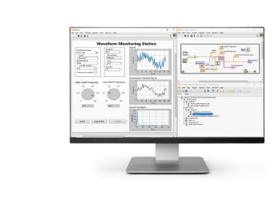
Hardware Scalability Up to 12 Sensors
DC Power Source
9 Volts
12
11
10
1
12 Sensor Platform
9
2
8
3
7
4
5
6
Port A
Port A
Port B
Port B
LabVIEW Program

Slide 20
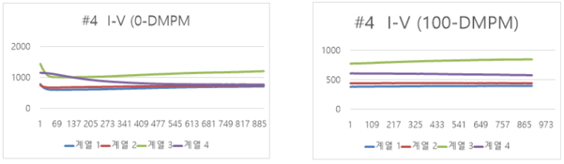
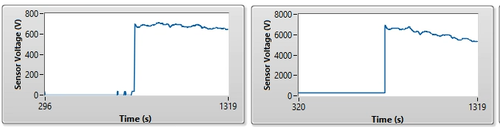
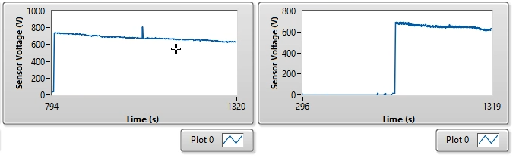
Expected Results and Testing
5 Micro Molar
Company Provided Results
Our Results

Slide 21
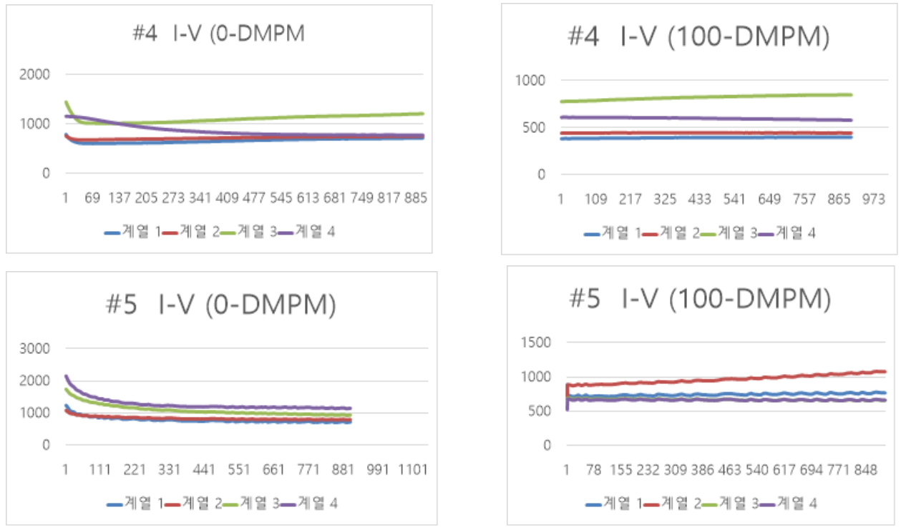
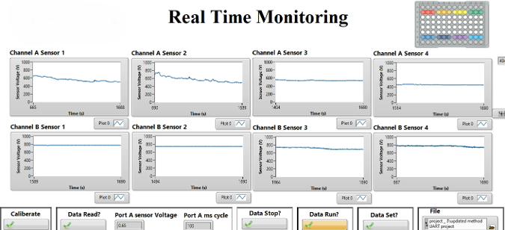
Expected Results and Testing
100 Micro Molar
Our Results
Company Provided Results

Slide 22
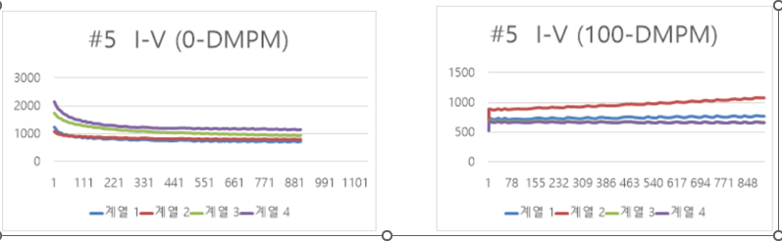
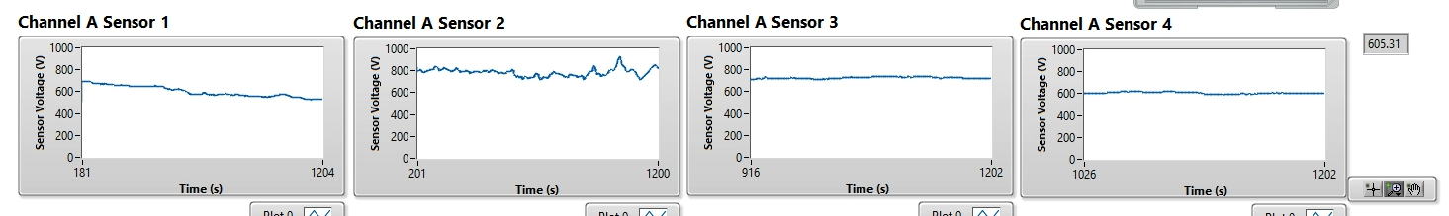
Expected Results and Testing
500 Micro Molar
Company Provided Results
Our Results

Slide 23
Expected Results and Testing
Excel Data Comparison
Our Results in LabView Software
Company Provided Results on Docklight

Slide 24
Why We Use myRIO?
Real-Time Data Processing: Real-time handle fast and continuous data acquisition from various sensors.
Graphical Programming with LabVIEW: myRIO is programmed using LabVIEW, which offers graphical interface, makes it easier to visualize and analyze the sensor data.
Data Logging and Storage: myRIO supports data logging, enabling long-term storage of sensor data for post-experiment analysis.
Scalability and Modularity: Easily expands to accommodate more sensors.

Slide 25
Non-Enzymatic Amperometric Glucose Sensor (Copper & Copper Oxide)
What is It?
Non-enzymatic amperometric glucose sensor.
Based on copper and copper oxide particles deposited on a screen-printed electrode.
Utilizes electrochemical oxidation of glucose to generate an electrical signal.
How It Works?
Glucose Oxidation:
Glucose interacts with copper oxide, undergoing oxidation.
This reaction produces CuO and gluconolactone, releasing electrons.
Signal Generation:
The released electrons generate an amperometric current.
The current is directly proportional to the glucose concentration.
Real-Time Monitoring:
Signal data is acquired and processed in real time using Board and myRIO for analysis.

Slide 26
References
A Comprehensive Review of Biosensor Integration in Microphysiological Systems for Online Monitoring: Current Challenges and Future Advancements.
Monitoring of Microphysiological Systems: Integrating Sensors and Real-Time Data Analysis Toward Autonomous Decision Making

Slide 27

Thank You! Feedback and Questions

